Slide 1
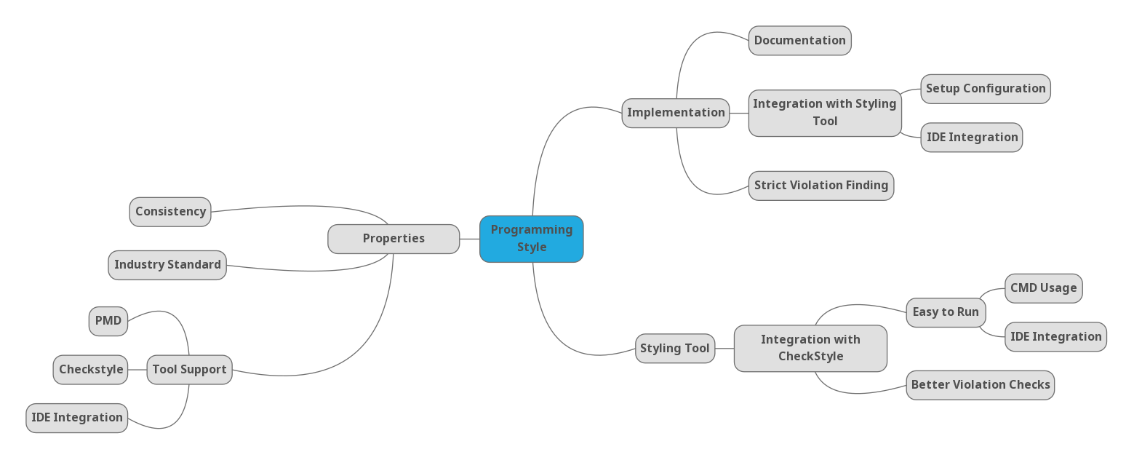
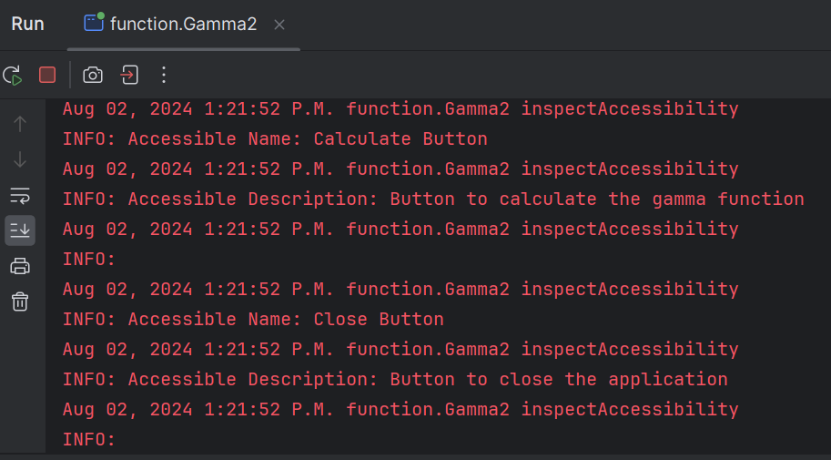
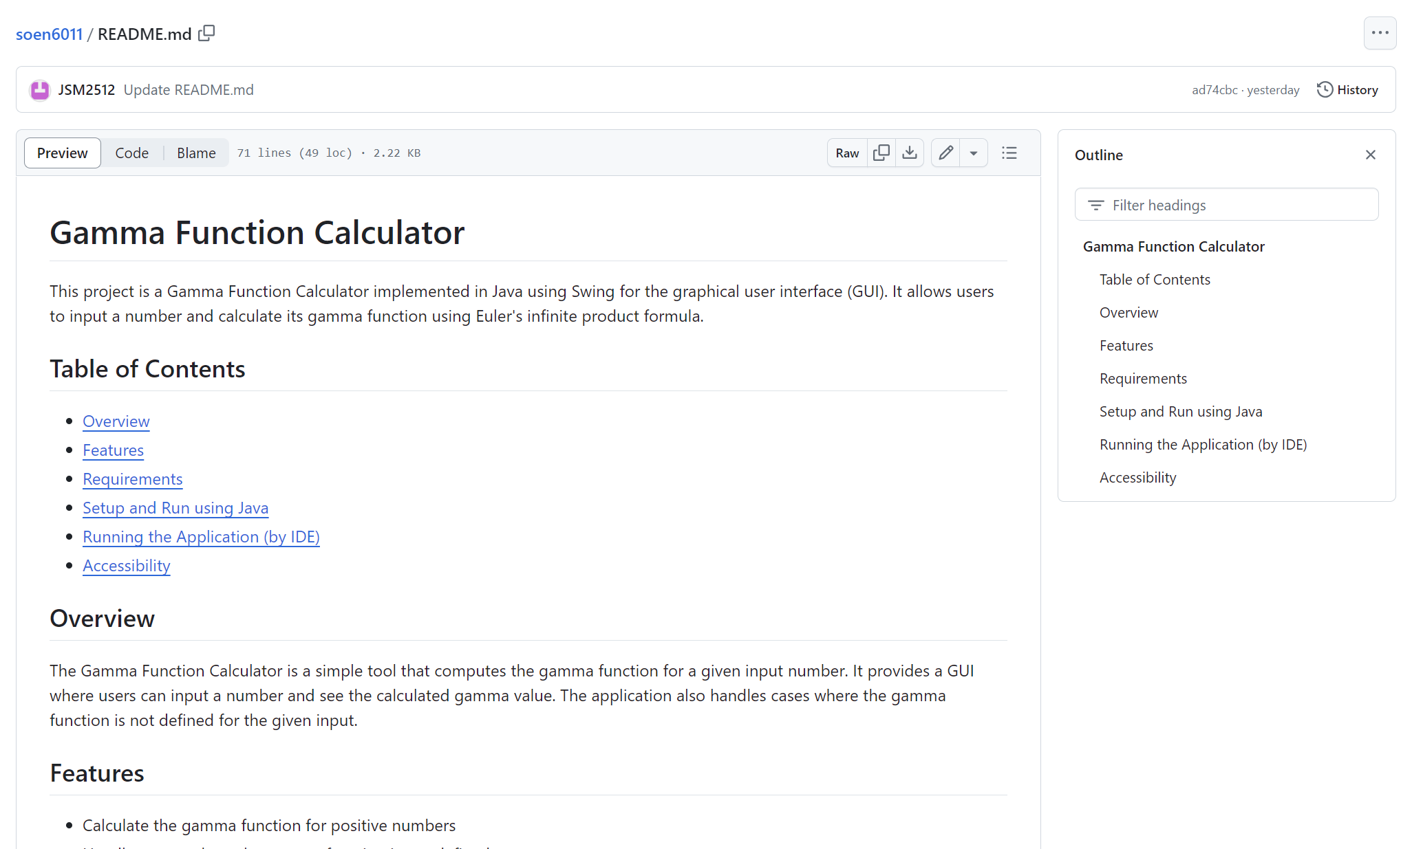
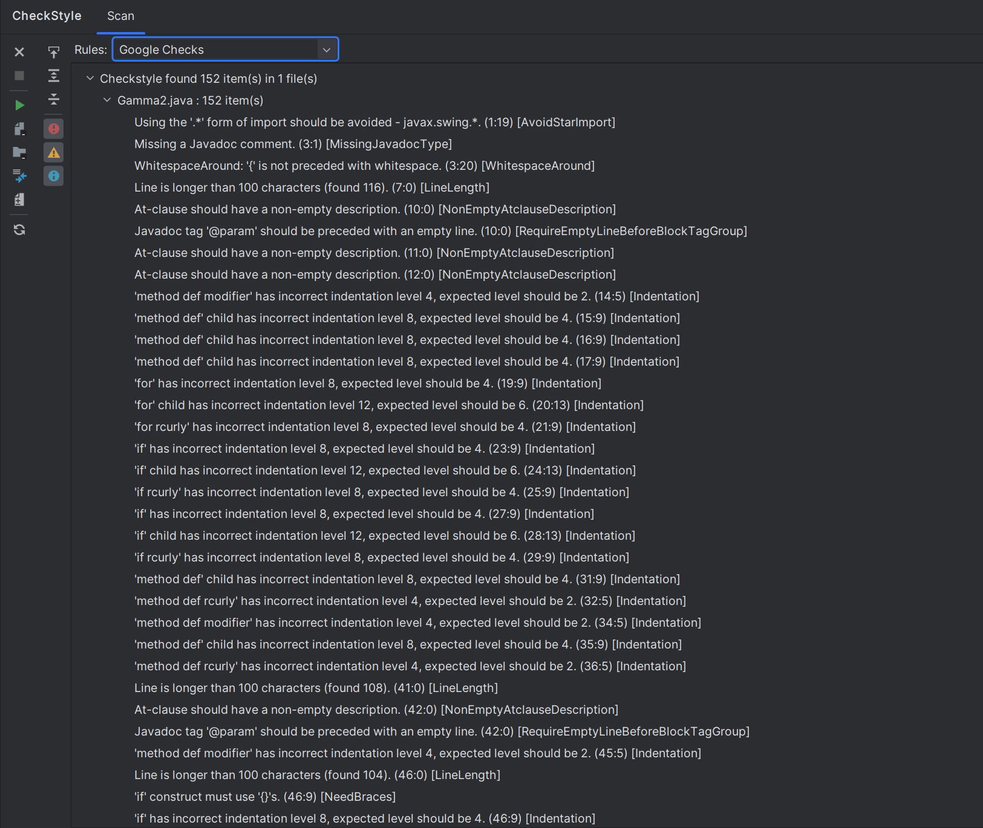
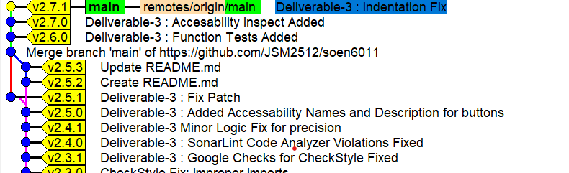
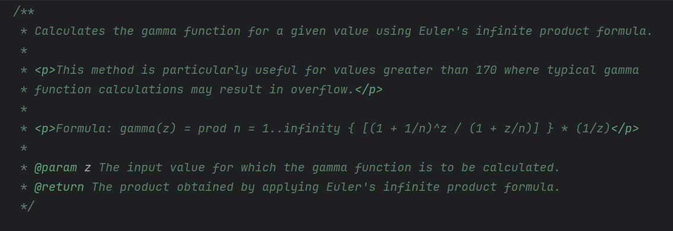
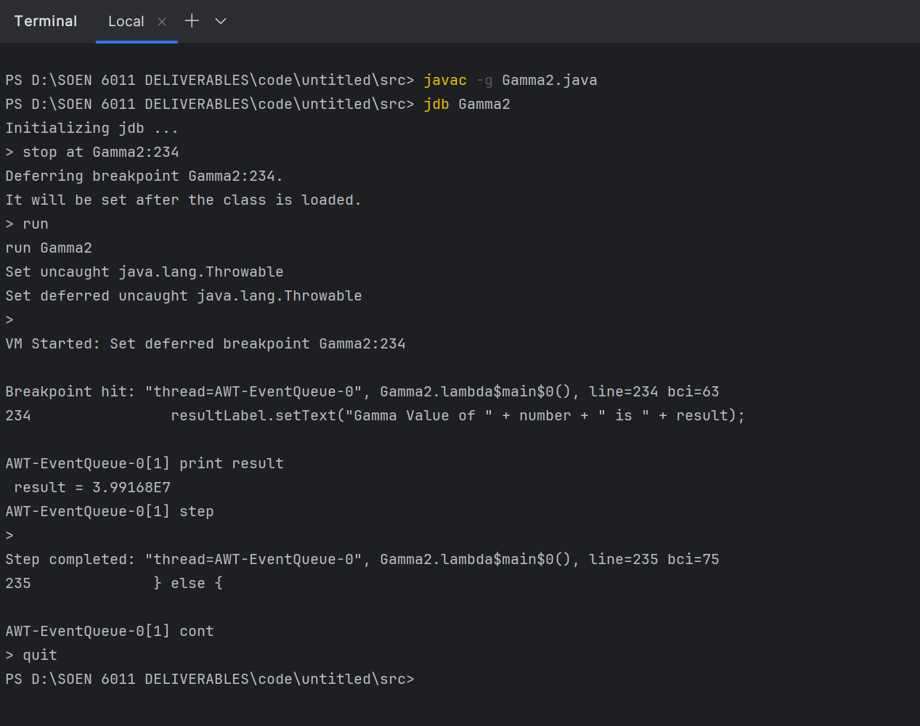

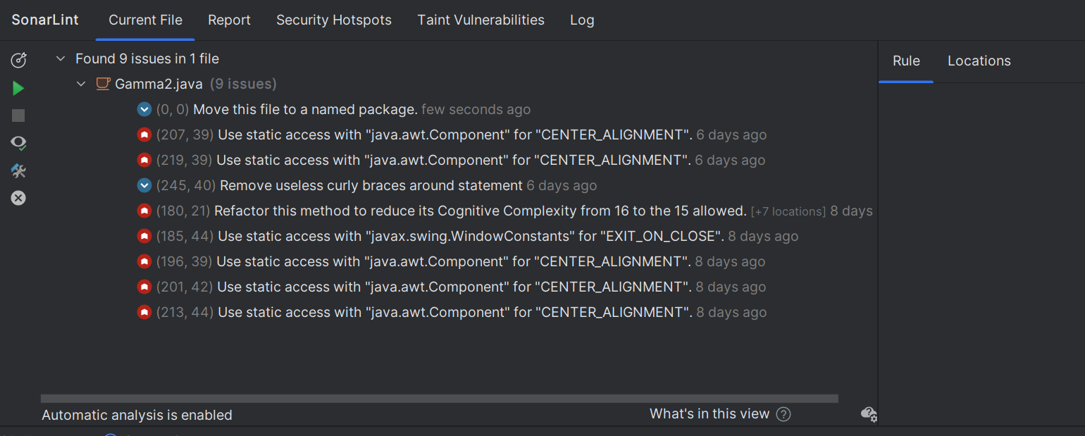
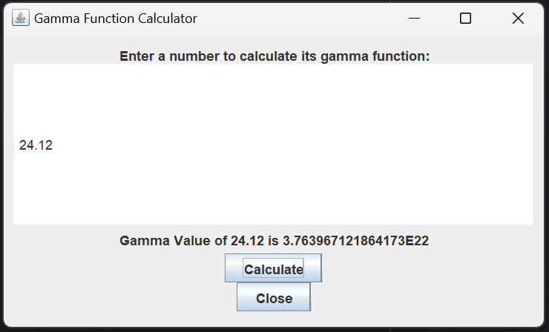
PROJECT ETERNITY (F4 : Gamma Function)
Jaiwant Singh Mahun
SOEN 6011 (Summer 2024)
ABSTRACT
ENSURE CODE QUALITY
To maintain high code quality, a mind map was created to select the Google Java Format for coding style based on properties.
CheckStyle was then used to enforce this standard, maintaining consistency and readability throughout the codebase.
Javadoc comments were added to document the functionality of methods and classes, improving code maintainability.
CONDUCT STATIC CODE ANALYSIS
SonarLint was employed for static code analysis to identify and rectify potential issues. This tool helps in detecting bugs, code smells, and vulnerabilities, enhancing code reliability and quality.
ACCESSIBILITY TESTING
The Java Accessibility API was used to set properties like AccessibleName and AccessibleDescription for GUI components. This ensures the application is accessible to users. Inspection using Logger was used as displayed below:
SEMANTIC VERSIONING
Semantic Versioning was used to systematically manage and communicate updates. We adhered to the format MAJOR.MINOR.PATCH to indicate changes. Major versions signal significant changes, minor versions for backward-compatible enhancements, and patches for fixes.
USE OF DEBUGGER
JDB (Java Debugger) was utilized to debug the application, providing capabilities such as breakpoints, code stepping, and variable inspection to ensure the correct functioning of both the Gamma function and GUI.
HOST IN A PUBLIC REPOSITORY
Place the Java source code in a public distributed version control system (e.g., GitHub), with high-quality commit messages and a comprehensive README file, promoting transparency and collaboration.
Link : https://github.com/JSM2512/soen6011
The Gamma Function, an extension of the factorial function to complex and real number arguments, plays a pivotal role in various fields of mathematics and applied sciences. This project presents the implementation of the Gamma Function calculator using Java, leveraging Factorial and Euler's infinite product formula for computation. The application features a user-friendly graphical interface developed with Java Swing, ensuring accessibility and adherence to established programming styles. Through rigorous use of styling tools such as CheckStyle, and static code analyzers like SonarLint, the project maintains high code quality and conformance to semantic versioning. The integration of the Java Accessibility API aims to make the application accessible to a broader audience. This poster outlines the project's objectives, methods, results, and conclusions, providing insights into the practical implementation and testing of the Gamma Function in a software application.
OBJECTIVES
Implement the Gamma Function: Develop a robust implementation of the Gamma Function using Euler's infinite product formula, capable of handling both integer and non-integer inputs.
Develop a User-Friendly GUI: Create an intuitive and accessible graphical user interface using Java Swing, allowing users to input values and view the computed Gamma Function results.
Ensure Code Quality: Identify and Adhere to established Java programming styles, using tools like CheckStyle to enforce coding standards and maintainable code.
Conduct Static Code Analysis: Utilize static code analysis tools such as SonarQube (SonarLint) to identify and fix potential issues, ensuring code reliability and performance.
Implement Accessibility Features: Leverage the Java Accessibility API to make the application accessible to users, enhancing usability for a wider audience.
Adopt Semantic Versioning: Implement semantic versioning in the project's source code to clearly communicate changes and ensure systematic version control.
Use a Debugger: Apply debugging tools such as JDB to troubleshoot and verify the correctness of the implementation, ensuring the accuracy of the Gamma Function calculations.
Host in a Public Repository: Place the Java source code in a public distributed version control system (e.g., GitHub), with high-quality commit messages and a comprehensive README file, promoting transparency and collaboration.
CONCLUSIONS
In this project, we meticulously enhanced the Gamma function calculator to adhere to modern software development standards. Conclusions are as follows :
High-Quality Code: The project incorporated Google Java Format for coding style consistency, validated through CheckStyle for adherence to established standards.
Effective Debugging: JDB was employed to ensure the correctness and stability of the codebase, demonstrating effective debugging practices.
Static Code Analysis: Static code analyzers, such as SonarLint, were used to identify and rectify potential issues, enhancing code reliability.
Semantic Versioning: Implemented Semantic Versioning to manage code changes and releases systematically, ensuring clear version tracking and updates.
User Interface Design: Applied user interface design principles and accessibility features, using the Java Accessibility API to create an inclusive and user-friendly GUI.
METHODOLOGY AND RESULTS
REFERENCES
IIMPLEMENTATION OF GAMMA FUNCTION
The Gamma function was implemented using Euler's infinite product formula to handle large inputs effectively. This method supports both integer and non-integer values, ensuring accuracy through series expansions and recursion.
DEVELOP USER-FRIENDLY GUI
A Java Swing GUI was designed for the Gamma function calculator. Key components include JFrame, JPanel, JLabel, JTextField, and JButton, arranged for clarity and ease of use, allowing straightforward input and result display. Key Points of Your GUI Design are : Simple, Consistent, Providing feedback by resultLabel, Error Handling.
[1] https://mathworld.wolfram.com/GammaFunction.html
[2] https://en.wikipedia.org/wiki/Gamma_function
[3]https://math.libretexts.org/Bookshelves/Analysis/Complex_Variables_with_Applications_(Orloff)/14%3A_Analytic_Continuation_and_the_Gamma_Function/14.02%3A_Definition_and_properties_of_the_Gamma_function
[4]https://en.wikipedia.org/wiki/Stirling%27s_approximation
[5]https://www.roma1.infn.it/~bonvini/math/Marco_Bonvini__Gamma_function.pdf
[6]https://www.javatpoint.com/javafx-tutorial
[7]https://google.github.io/styleguide/javaguide.html
[8]https://checkstyle.sourceforge.io/google_style.html
[9]https://plugins.jetbrains.com/plugin/7973-sonarlint
[10]https://semver.org/
[11]https://www.tutorialspoint.com/jdb/index.htm
[12]https://github.com/
CONTACT
JAIWANT SINGH MAHUN
40270569
Github Repository : https://github.com/JSM2512/soen6011

